Slide 1
YouTube Comment Analyzer Using NLP

Slide 2
Definition
A YouTube Comment Analyzer is a system or tool that automatically collects, processes, and analyzes comments associated with YouTube videos. It utilizes various techniques, including natural language processing (NLP) and sentiment analysis, to derive insights into user sentiments, engagement, and topics discussed in the comments section.

Slide 3
Tools
Programming Language: Use a programming language such as Python for model train. And for website use MERN Stack
IDE (Integrated Development Environment): Jupyter Notebook or Visual Studio Code
Version Control: Utilize version control systems like Git to track.
Collaboration Tools: Use collaboration tools like GitHub for version control

Slide 4
Resources
YouTube Data API
Kaggle : for dataset train and test our model.
Websites
Social bee
Hootsuite
Brand watch

Slide 5
Library
Visualization Tools: Matplotlib
NLP Libraries: SpaCy
Machine Learning Models: Scikit-learn

Slide 6
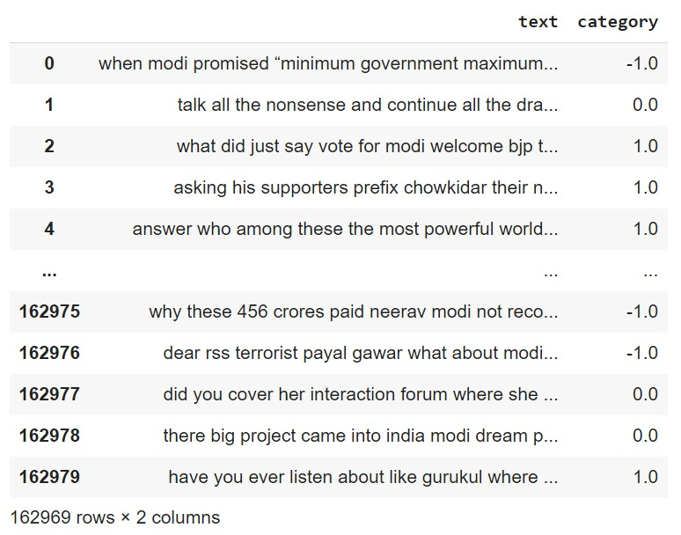
Comments Dataset

Slide 7
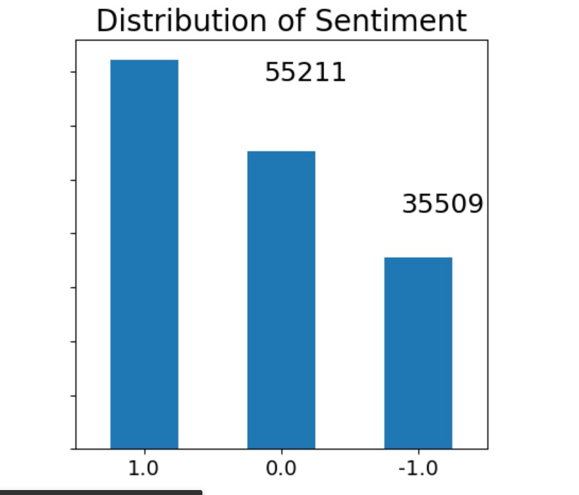

Slide 8
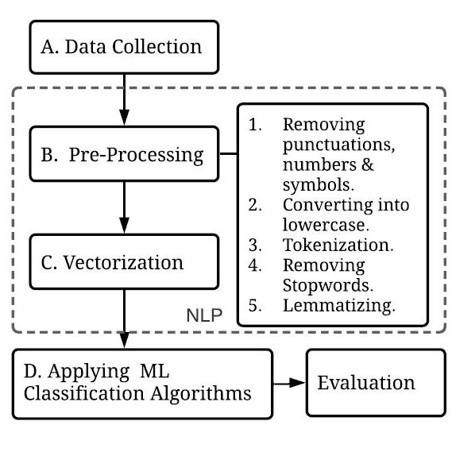
Flow Diagram

Slide 9
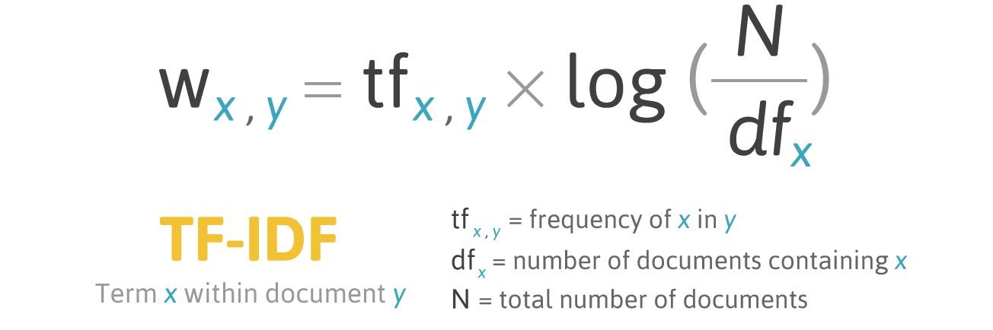
Train_model with TFIDF

Slide 10
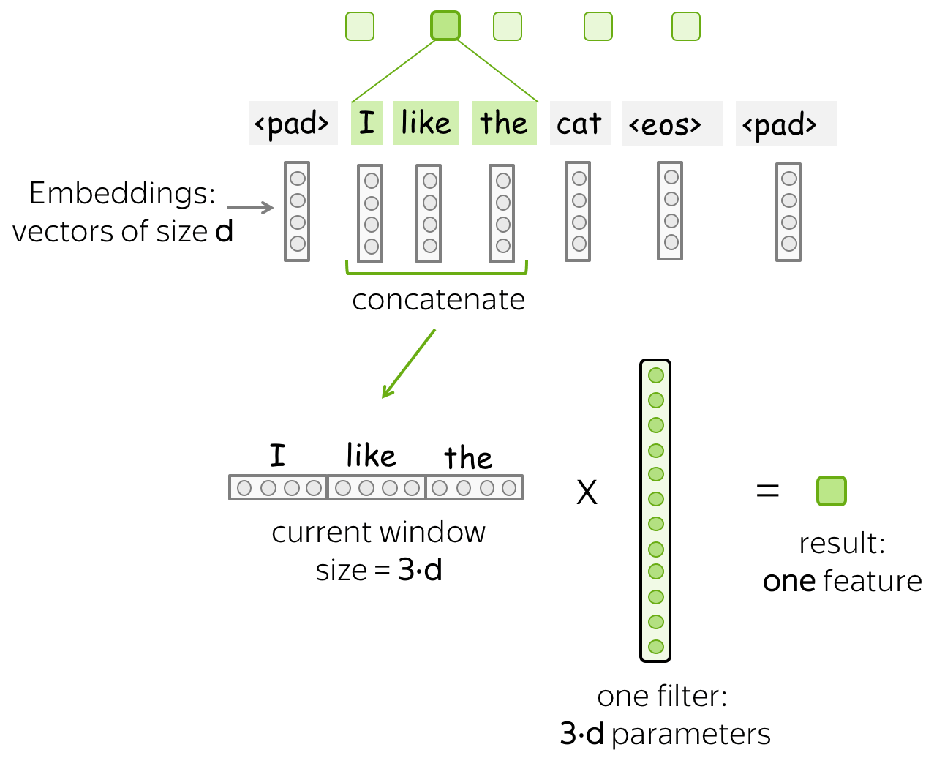
Train_model with Word Embedding

Slide 11
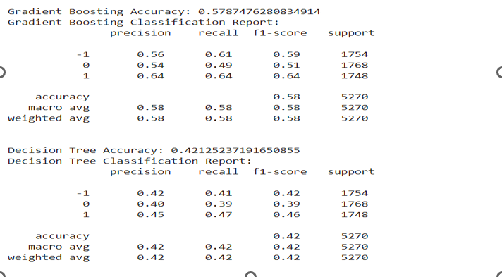
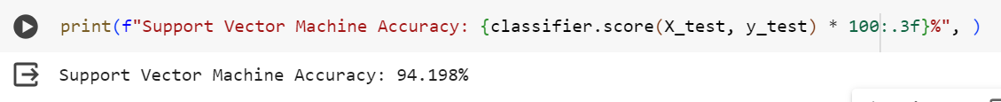
Accuracy

Slide 12
SVM Model(Support Vector Machine)
Support Vector Machine — Formulation and Derivation | by Atul Agarwal | Towards Data Science

Slide 13
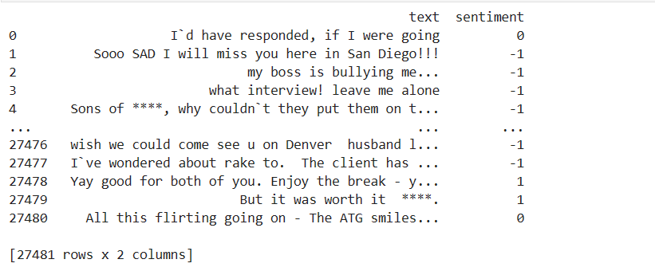
Resulting dataset

Slide 14
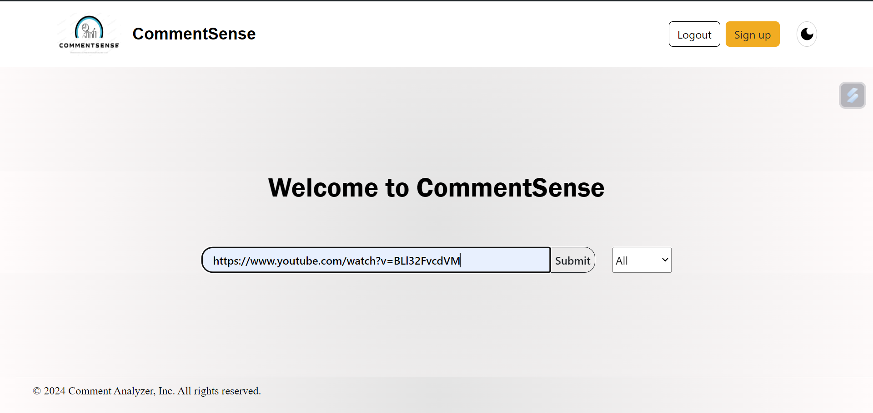
Web App

Slide 15
